Slide 1
Media & Baby names
Jerod Spence

Slide 2

Agenda
GOT baby names?
LORD OF THE baby names?
WHY AM I named this?

Slide 3
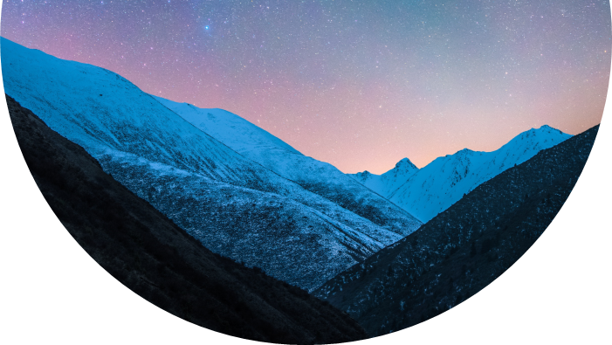
Introduction
When you are first introduced to someone, what is something that you try your hardest to remember? Of course, facial features and other unique identifiers are a common answer, however a person's name is a great starting point. Now everyone knows a John, Amber, Rick, or even a Sam. But what about a Darth Vader or Kobe? While those names bring forth completely different feelings most likely, they have one thing in common. They are both names associated with famous people, either fictitious or not, and are easily recognizable. This project is meant to shed light on how heavily influenced people's lives are by things seen on TV, heard on the radio, or read in books. Why do people name their children after these characters? What about that character influences the parent to choose that name? Let’s take a look at the data.

Slide 4
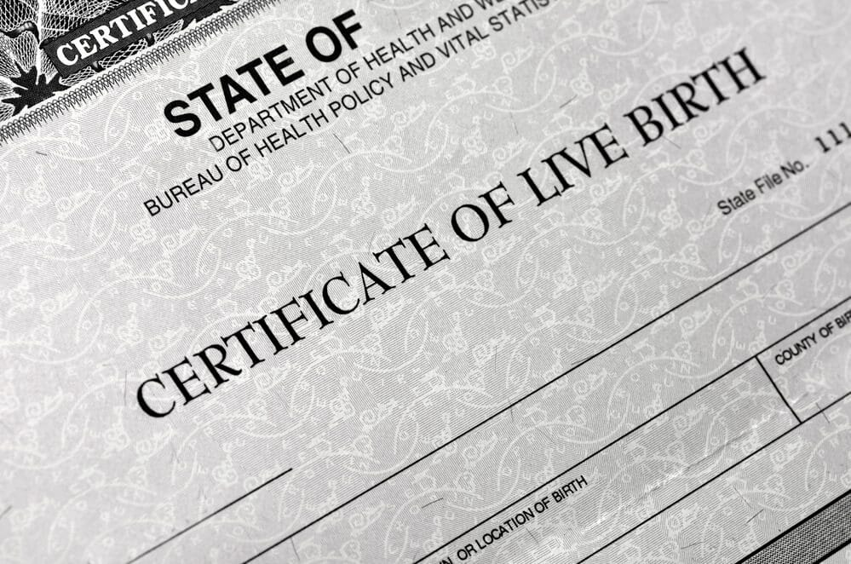
What makes a name?
People choose names of fictional or non-fictional people for various reasons, often influenced by personal connections, admiration, symbolism, or the desire to pay homage to a beloved character or historical figure.
Personal Connections: Some choose a name due to a very personal connection to the movie or character in that movie. The same sentiment can be applied to athletes, superstars, and famous historical figures.
Admiration and Inspiration: Some also choose a name because they admire the personality traits of said person/character.
Symbolism and Meaning: Fictional or non-fictional names may carry symbolic or metaphorical meanings that resonate with individuals.
Popularity and Cultural Influence: Names of popular fictional characters or historical figures often gain widespread recognition and become cultural touchstones.
Nostalgia and Sentimentality: Naming someone after a fictional or non-fictional character can evoke a sense of nostalgia and sentimental attachment. Some choose a character name from a movie they watched with a loved one.
Uniqueness and Individuality: Certain names are simply unique and promote individuality.
It's important to note that the reasons for choosing names of fictional or non-fictional people vary greatly from person to person, and the significance behind these choices can be deeply personal. Ultimately, the selection of such names reflects the individual's own narrative, values, and cultural influences.

Slide 5
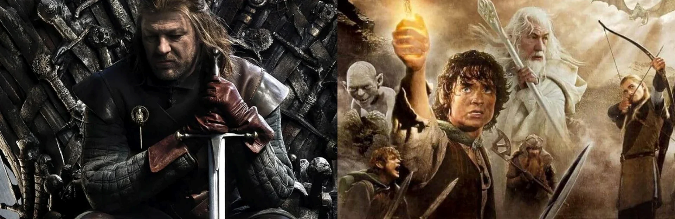
characters in fiction
Game of Thrones & Lord of the Rings

Slide 6
Characters in Fiction
Game of Thrones
The Lord of the Rings
Arya Stark – Arya Stark is a fiercely independent and determined character from Game of Thrones. Trained as an assassin, she seeks justice and revenge while displaying unwavering loyalty to her loved ones. Arya's resilience and adaptability make her a formidable force in her quest for survival.
Daenerys Targaryen - Daenerys Targaryen is a complex character whose personality combines determination, resilience, compassion, and ambition. Her journey in Game of Thrones explores the tension between her noble intentions and the consequences of her actions. Daenerys' evolution from a vulnerable exile to a powerful ruler leaves a lasting impact on the audience, prompting discussions about power, morality, and the complexities of leadership.
Tyrion Lannister - Tyrion Lannister is a charismatic and intellectually sharp character in Game of Thrones. His wit, intelligence, and empathy set him apart, allowing him to navigate the intricate webs of power and influence. Despite facing numerous challenges, he remains a complex and resilient figure, captivating audiences with his mix of charm, intelligence, and vulnerability.
Aragorn - Aragorn embodies the qualities of a heroic leader in The Lord of the Rings. His courage, selflessness, humility, and sense of duty make him a revered figure. Aragorn's growth from a reluctant hero to a true king serves as an inspiring narrative, capturing the essence of honor, sacrifice, and the pursuit of a greater destiny.
Arwen - Arwen is a luminous and enchanting character in The Lord of the Rings. Her love, loyalty, wisdom, and magical abilities make her an essential figure in the story. Arwen's portrayal captures the themes of sacrifice, eternal love, and the profound impact an individual can have on the course of history
Galadriel - Galadriel is a captivating and powerful character in The Lord of the Rings. Her wisdom, strength, and unwavering commitment to the greater good make her a revered figure. Galadriel's portrayal encapsulates the timeless themes of sacrifice, courage, and the eternal struggle between light and darkness.

Slide 7

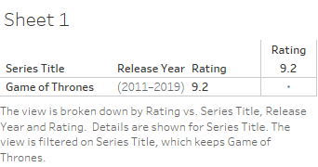
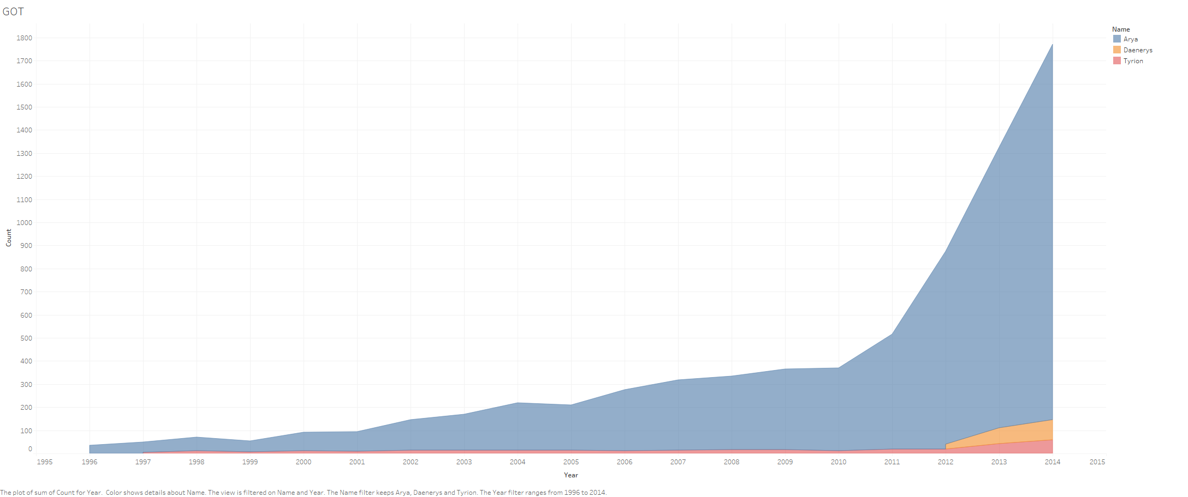
Game of Thrones

Slide 8
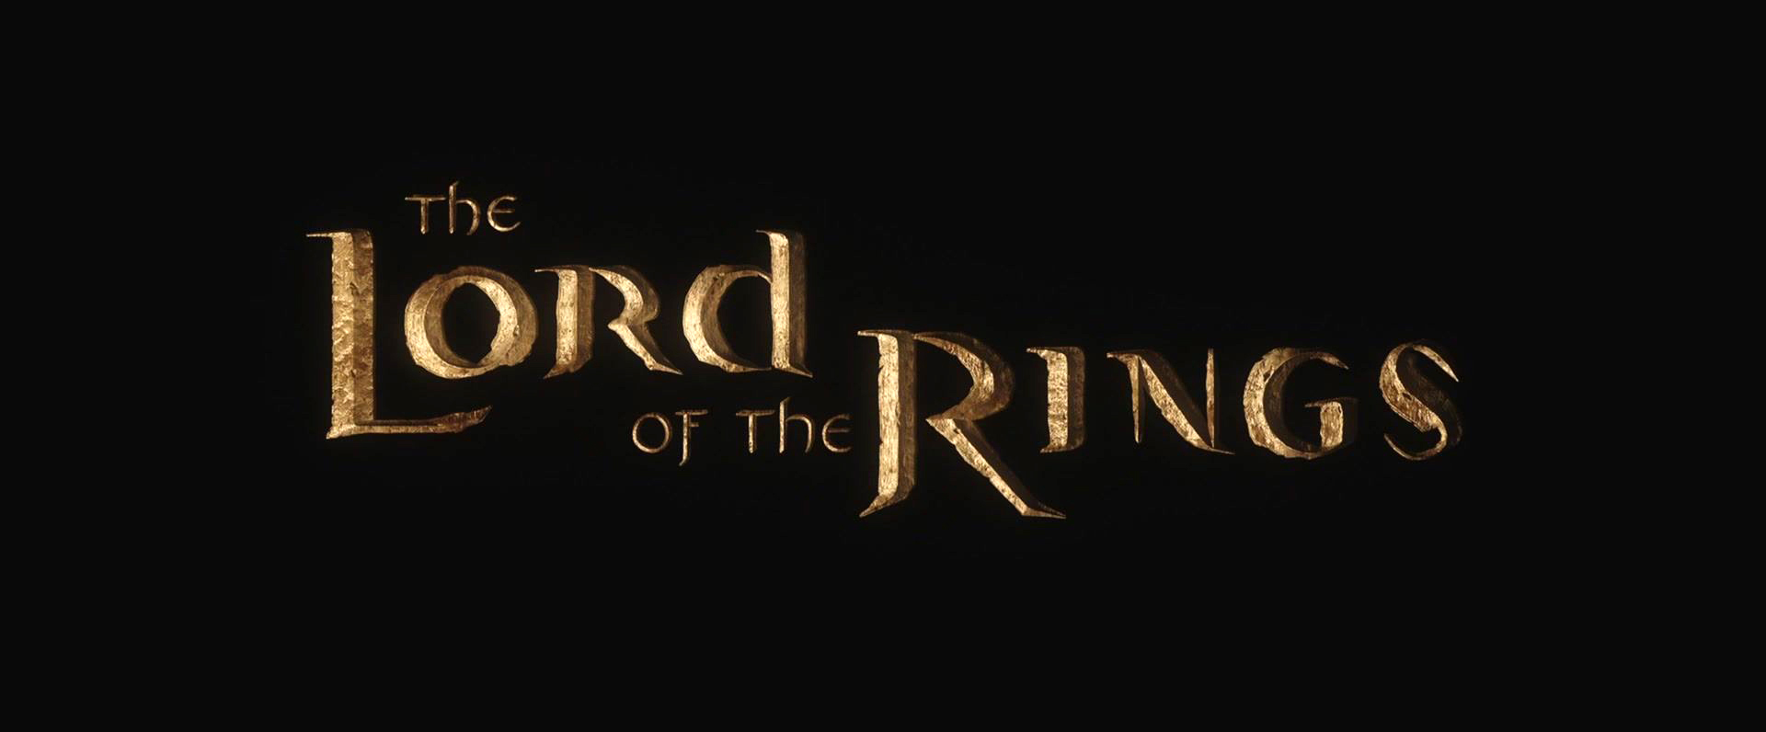
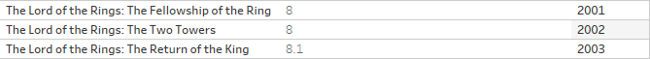
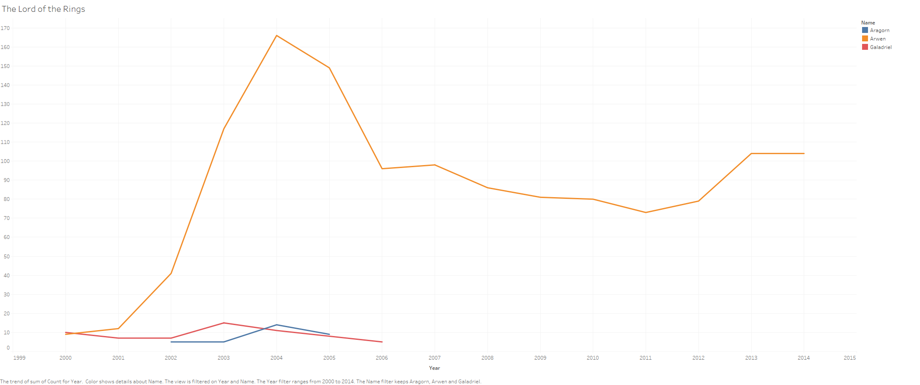
The Lord of the Rings

Slide 9
The way to get started is to quit talking and begin doing.
Walt Disney

Slide 10
Famous People
Sports & History

Slide 11
Timeline
Title
To start a presentation, go to the Slide Show tab, and select From Beginning.
Title
To display Presenter view, in Slide Show view, on the control bar at the bottom left select the three dots, and then Show Presenter View.
Title
During your presentation, the speaker notes are visible on your monitor, but aren't visible to the audience.
Title
The Notes pane is a box that appears below each slide. Tap it to add notes.
Title
If you don’t see the Notes pane or it is completely minimized, click Notes on the task bar across the bottom of the PowerPoint window.

Slide 12
Title
Subtitle
Subtitle
Add text, images, art, and videos.
Add transitions, animations, and motion.
Save to OneDrive, to get to your presentations from your computer, tablet, or phone.
Open the Design Ideas pane for instant slide makeovers.
When we have design ideas, we’ll show them to you right there.

Slide 13
Title
Subtitle
Subtitle
Subtitle
Add text, images, art, and videos.
Add transitions, animations, and motion.
Save to OneDrive, to get to your presentations from your computer, tablet, or phone.
Open the Design Ideas pane for instant slide makeovers.
When we have design ideas, we’ll show them to you right there.
This PowerPoint theme uses its own unique set of colors, fonts, and effects to create the overall look and feel of these slides.
PowerPoint has tons of themes to give your presentation just the right personality.

Slide 14



Summary
With PowerPoint, you can create presentations and share your work with others, wherever they are. Type the text you want here to get started. You can also add images, art, and videos on this template. Save to OneDrive and access your presentations from your computer, tablet, or phone.

Slide 15



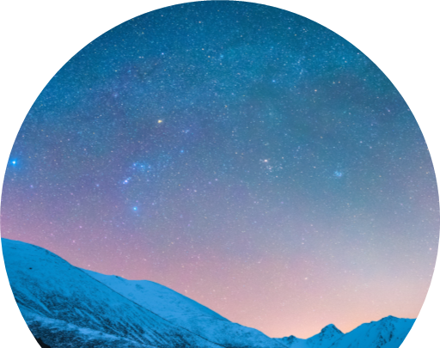
Thank you
Presenter name
Email address
Website

